Slide 1
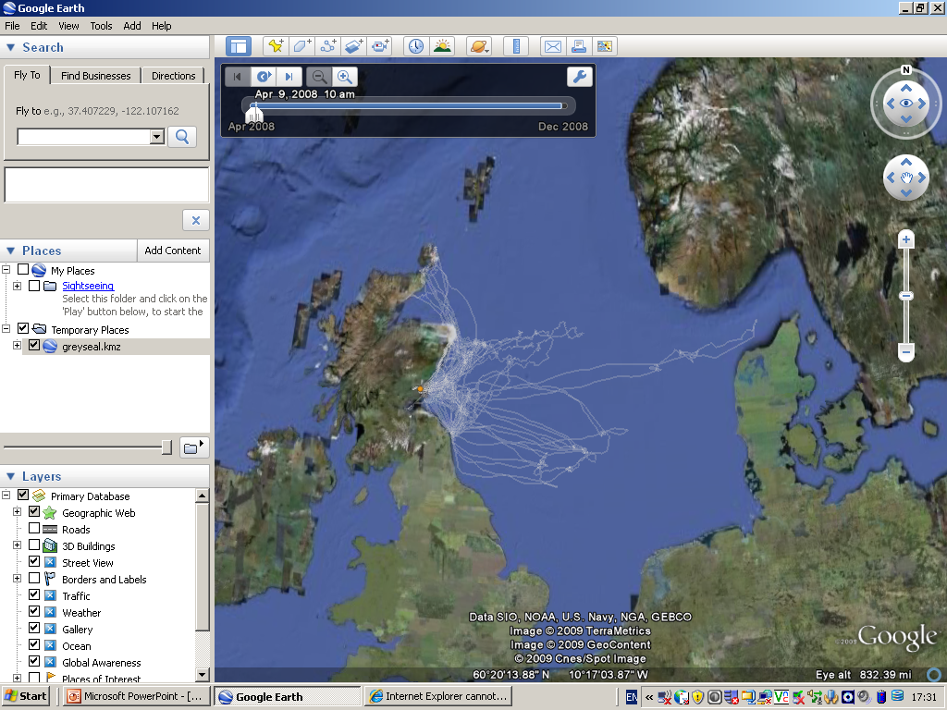
Open up greyseals.kmz and the file folders will appear in “Places”
And all the tracks will appear on the map.
1
2

Slide 2
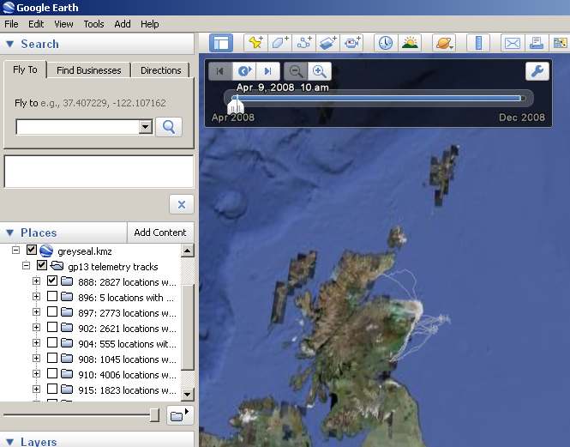
3. Open up the greyseals.kmz folders to reveal subfolders with data for each of the 10 seals.
4. Uncheck the boxes for all except one seal so that you can explore individual movements.
3
4

Slide 3
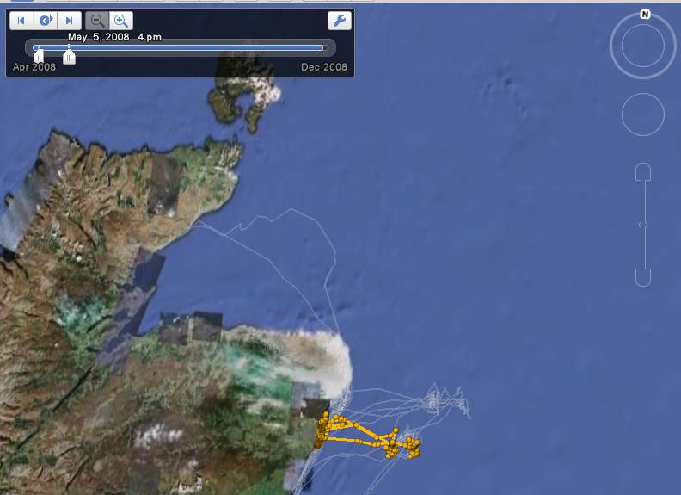
5. Zoom in to give more detail.
6. Use your cursor to separate the two white arrows. Then drag to the right to give a moving window of locations form different times during the deployment.
Separate these two white arrows
Track will appear highlighted on map

